Slide 1
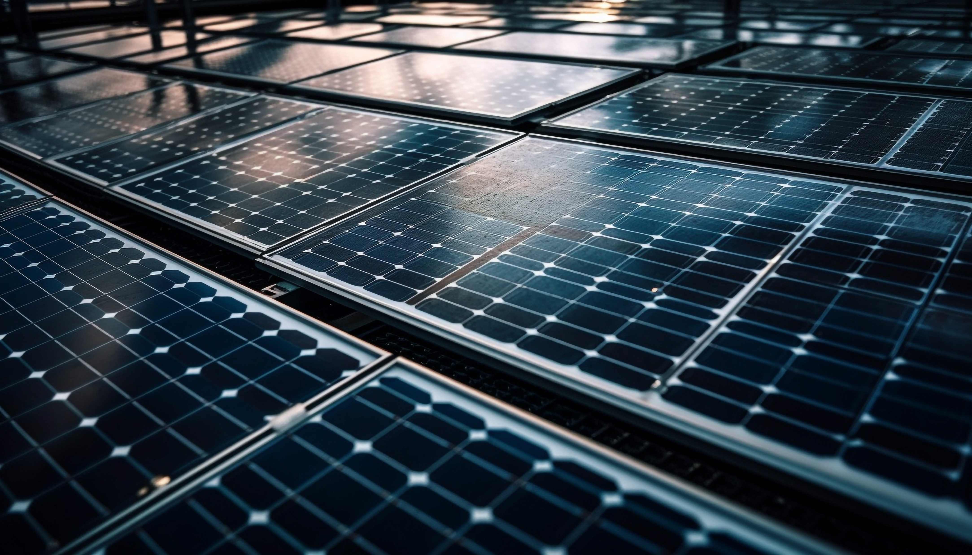

Solar Power Plant
& NTPC Share in Renewable

Slide 2
Renewable Energy
The world is facing an energy crisis and rising pollution because we rely too much on coal and oil, which are polluting and running out.
To protect our environment and support our growing needs, we must use renewable energy.
Solar energy is a clean, endless source from the sun. It does not pollute and is good for both people and nature.
Using solar power plants helps reduce pollution and provides electricity in a safe and eco-friendly way.

Slide 3
Manufacturing Process how Solar cell created ?
Solar cells are made from silicon, which is turned into a semiconductor by a process called doping— adding small amounts of impurities like phosphorus or aluminum.
Doping forms two types of semiconductors:
N-type (with extra electrons)
P-type (with holes or missing electrons)
P-N Junction is formed when these 2 types of semiconductor are joined and this created a depletion region (a zone with no free charge carrier).

Slide 4
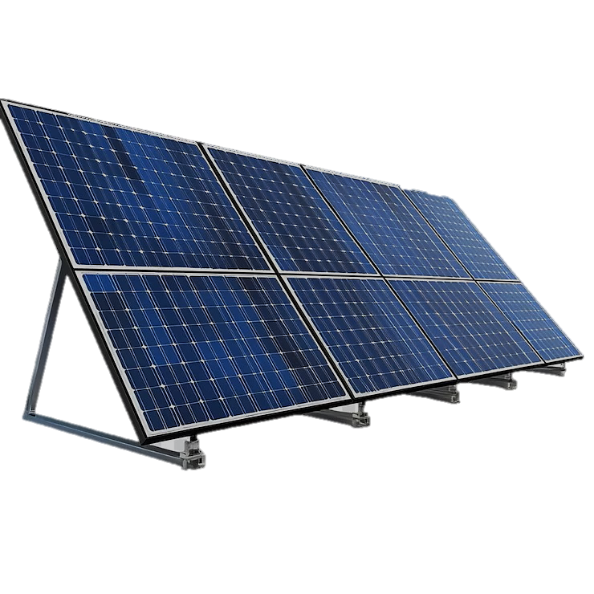
Solar Energy
Earth intercepts 173 KTW of solar energy annually.
The sun’s energy helps plants grow. When we burn those plants, the stored energy is released as heat.
Burning plants is an indirect use of solar energy.
We mainly use solar energy by directly converting sunlight into electricity using solar panels.
This Solar panel use Photovoltaic Cell for conversion of Solar energy directly to electricity.

Slide 5
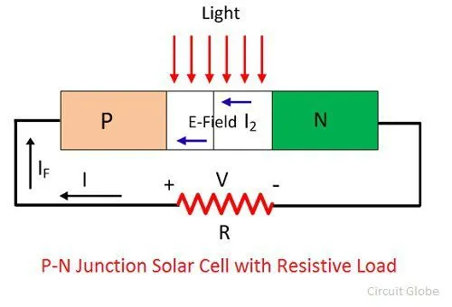
Working how Solar cell Work ?
Sunlight hits the solar cell.
Light energy knocks electrons loose in the semiconductor (usually silicon).
The P-N junction pushes these free electrons in one direction.
This flow of electrons creates electric current.
Metal contacts collect the current and send it out as usable electricity.

Slide 6
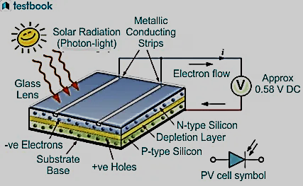
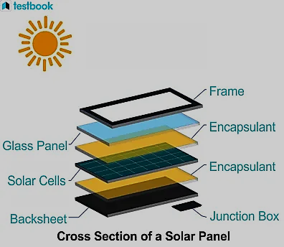
Working of a Solar Cell
Structure of a Solar Cell

Slide 7
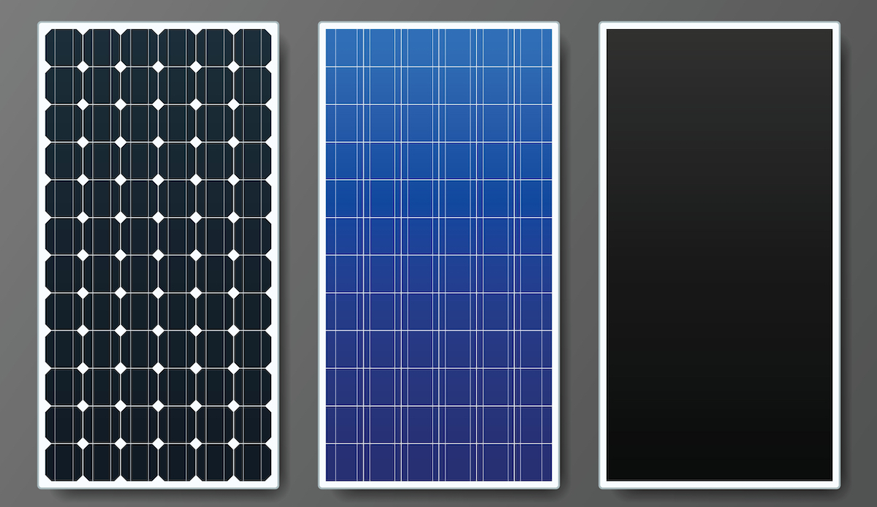
Types of PV Materials
Thin-Film Solar Cells
Monocrystalline Silicon
Polycrystalline Silicon
Made from: Mono-Si.
Efficiency: High (18–22%)
Appearance: Black.
Used in: Solar Plant
Advantage: it can use where no direct sunlight is present able to make electricity from heat wave.
Made from: Multi-Si
Efficiency: Mid (15–17%)
Appearance: Blue.
Used in: Residential panel
Advantage: it is cheaper than Monocrystalline Silicon and best for commercial use
Made from: CdTe, a-Si, CIGS.
Efficiency: Lower (10-13%)
Appearance: Flexible .
Used in: Portable system
Advantage: As it is flexible and Lightweight it usually integrated with other for solar energy.

Slide 8
NTPC Faridabad 5 MW Solar Plant
Location: Jhajru village, 17km to NTPC’s Faridabad gas‐based power station in Haryana.
Capacity: 5 MW, constructed on approx. 20 acres.
Output: Around 7.4–8 million kWh electricity per year enough to power roughly 6,000 households.
Carbon Savings: approx. 7,000 tonnes CO₂ annually.
Commissioning: As part of India’s Jawaharlal Nehru National Solar Mission, the plant was commissioned in 2013.
Technology Used : Monocrystalline silicon photovoltaic modules mounted on fixed structures

Slide 9
Layout of Solar Plant
A string is a group of solar panels connected in series.
A string consist 24 panels in series.
Rating of each panels : 29V & 7.5A
There are total 452 strings.
Rating of each string : 696V & 7.5A
1
2
24
……………
SCB – String Combiner Box
There are total 64 SCB.
1 SCB connects 8 strings in parallel
Rating of SCB : 696V & 60A
1 SCB have total 11 port.
8 input , 2 output & 1 earthing port
……………
8 String Input
Solar panels generate DC.
Homes and grid systems use AC.
So, an inverter is use for conversion.
8 SCB connected to 1 Inverter .
There are total 8 Inverter.
Inverter
SCB

Slide 10
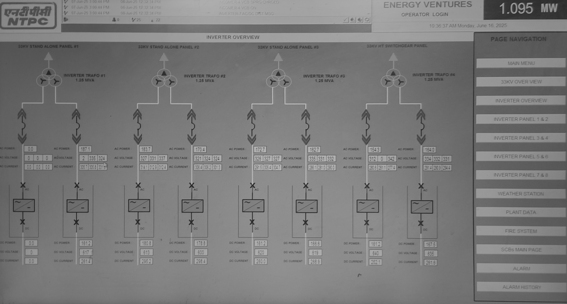
Inverter
Inverter
2 Inverter – 1 Transformer
There are total of 4 Transformer .
Output of each Transformer connected to parallel to each other and transmit through transmission tower.
1.25MVA
1.25MVA
Star Connection
All this output of plant are observed by SCADA. It monitors the solar plant in real time, tracks output, detects faults, and enables remote control for safe operation.
Power Transformer
33KV
Delta Connection
The output from this transformer is sent to the Faridabad Gas Power Station (FGPS), where it is stepped up to 220 kV using a transformer and then connected to the main bus through essential equipment.

Slide 11
NTPC Share In Renewables
NTPC (National Thermal Power Corporation) is India’s largest energy producer.
Traditionally focused on coal and gas, now expanding aggressively into renewables.
As of 2024, NTPC has over 3,200 MW of installed renewable capacity (mostly solar, wind & hydro).
Additionally, under-construction renewable projects exceed 5,000 MW.
It contributes a significant share to India’s total solar capacity through utility-scale solar parks and hybrid projects.

Slide 12
NTPC aims for 60 GW of renewable energy till 2032.
This will make up about 45% of its total capacity, reducing dependence on coal.
Large-scale solar parks in Rajasthan, Gujarat, Madhya Pradesh.
Floating solar plants in reservoirs at Ramagundam, Kayamkulam, Simhadri.
Green hydrogen and offshore wind pilot projects.
Active participant in national missions like:
1. Jawaharlal Nehru National Solar Mission
2. PM-KUSUM
3. Ultra Mega Renewable Energy Parks

Slide 13
Special Thanks :
1. S.S Narula Sir
2. Kaushal Sir
3. Prashant sir
Thank You

